Slide 1
Scaling Network Verification to Large Networks: Progress and Opportunities
Qiao Xiang
Joint work with
Ridi Wen¹, Chenyang Huang¹, Jiwu Shu¹, Yichao Cheng², Ning Luo², Timos Antonopoulos²,
Ruzica Piskac², Y. Richard Yang², Dong Guo³, Jingxuan Zhang³, Ying Zhang⁴
¹Xiamen University, ²Yale University, ³Tongji University, ⁴Meta
11/09/2021, FoFoSDN'21

Slide 2
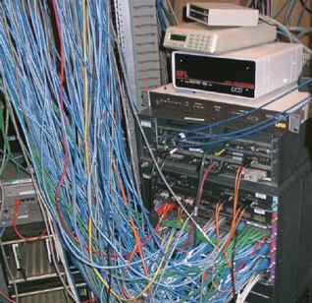
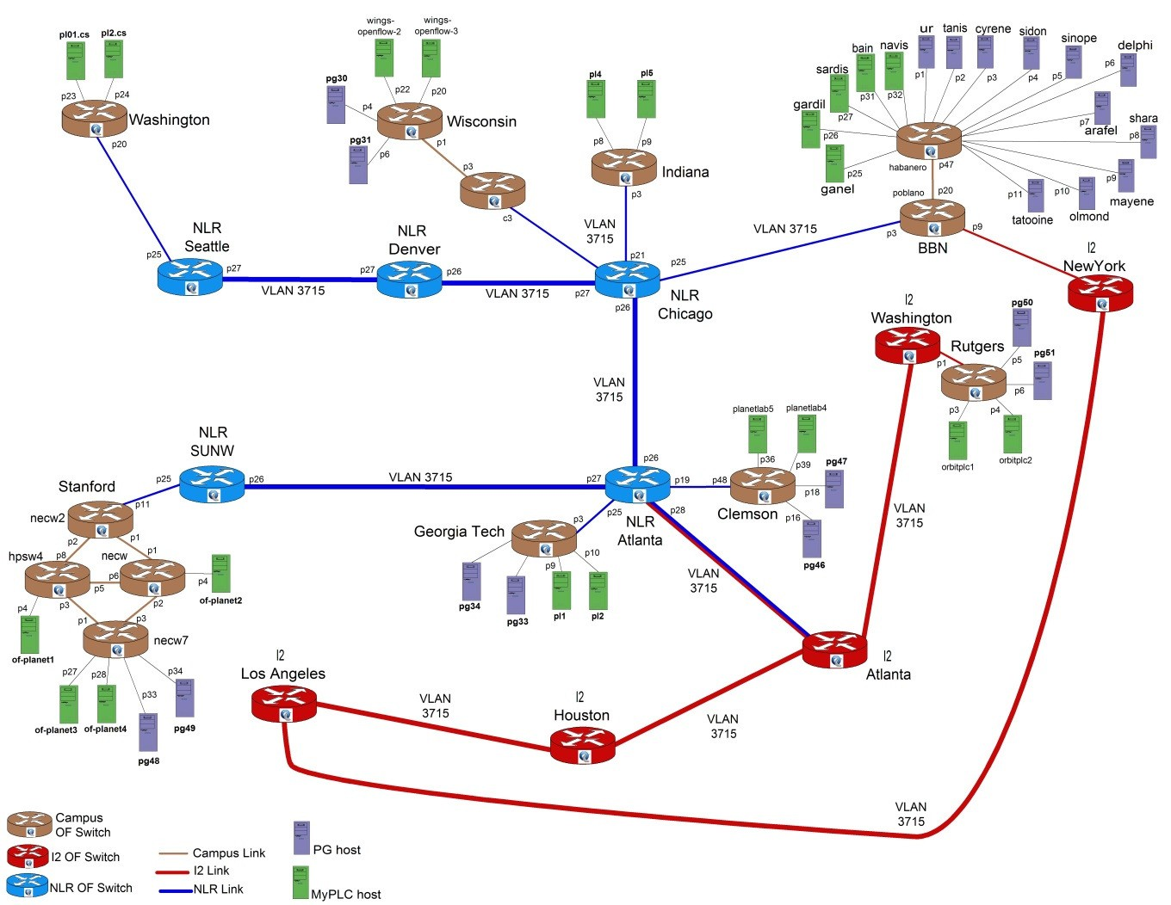

Network Verification: Background
Modern networks are
increasingly more complex
outages increasingly more costly
Network verification: verify whether the behavior of a network ensures network correctness properties.
Source: http://groups.geni.net/geni/chrome/site/thumbnails/wiki/TangoGENI/OF-VLAN3715_1000.jpg

Slide 3
Network Verification: Progress in the Community
CPV
Batfish
Minesweeper
ARC
Tiramisu
…
Network
Control plane
OSPF
BGP
…
config
config
config
DPV
Anteater
HSA
Veriflow
AP
APKeep
…
FIB
ACL
Data plane

Slide 4
Network Verification: Scaling Challenges
CPV
Batfish
Minesweeper
ARC
Tiramisu
…
Network
Network
Challenge 1:
How to simultaneously achieve high coverage (e.g., all converged states) and high efficiency?
Challenge 3:
How to verify interdomain network while preserving network privacy?
Control plane
OSPF
BGP
…
config
config
config
DPV
Anteater
HAS
Veriflow
AP
APKeep
…
FIB
ACL
Challenge 2:
How to swiftly verify generic properties in large-scale networks (e.g., data center networks)?
Data plane

Slide 5
This Talk: Recent Results on Scaling Network Verification
CPV
Batfish
Minesweeper
ARC
Tiramisu
…
Network
Network
Challenge 1:
How to simultaneously achieve high coverage (e.g., all converged states) and high efficiency?
Progress 3:
A Privacy-Preserving SAT Solver
Progress 1:
A Solvability Digraph Perspective of
the Stable Path Problem
Challenge 3:
How to verify interdomain network while preserving network privacy?
Control plane
OSPF
BGP
…
config
config
config
DPV
Anteater
HAS
Veriflow
AP
APKeep
…
FIB
ACL
Challenge 2:
How to swiftly verify generic properties in large-scale networks (e.g., data center networks)?
Progress 2:
A Generic, Distributed Data Plane
Verification Framework
Data plane

Slide 6
What is the Stable Path Problem?
Powerful tool for BGP convergence analysis [1], and the foundation of many CPV tools (e.g., Minesweeper)
An undirected graph G=(V, E)
n+1 nodes, node 0 represents the destination; a link represents neighborship
Each node i
runs SPVP, an abstract version of BGP
has a set of permitted paths
has a ranking function to rank permitted paths
Stable path assignment: each node's selected path
belongs to its permitted paths, and
is a concatenation of the selected path of its neighbors
Stable path problem (SPP): does a stable path assignment exists?
[1] Griffin, Timothy, et al. "The Stable Paths Problem and Interdomain Routing." IEEE/ACM Transactions On Networking 10, no. 2 (2002): 232-243.

Slide 7
Example: Good Gadget
A stable path assignment defines a tree rooted at node 0
Good gadget
Stable path assignment of good gadget

Slide 8
Categories on SPP Instances
Safe: SPVP always converges, e.g., good gadget
Unique: has one and only one stable path assignment, e.g., good gadget and naughty gadget
Solvable: has at least one stable path assignment, e.g., disagree
Unsolvable: has no stable path assignment, e.g., bad gadget
120
10
1
2
210
10
0
naughty gadget
disagree
bad gadget

Slide 9
Related Work on SPP
Focus of this work
Solvable
Unsolvable
Unique
Safe
Greedy+-solvable [2, 3]
Dispute-wheel-free [1]
Gao-Rexford[4]
[2] Cittadini, Luca, et al. "On the Stability of Interdomain Routing." ACM Computing Surveys 44, no. 4 (2012): 1-40.
[3] Cittadini, Luca, et al. "From Theory to Practice: Efficiently Checking BGP Configurations for Guaranteed Convergence." IEEE Transactions on Network and Service Management 8, no. 4 (2011): 387-400.
[4] Gao, Lixin et al. "Stable Internet routing without global coordination." IEEE/ACM Transactions on networking 9, no. 6 (2001): 681-692.

Slide 10
Why Focus on SPP Solvability?
Enable new interdomain routing use cases with more flexible policies
Better understand the gap between solvable SPP and safe SPP
Help improve the efficiency of network configuration verification

Slide 11
Main Findings: New SPP Solvability Results
Theorem: A novel solvability digraph for reasoning SPP solvability
Algorithm: A polynomial-time heuristic solves more SPP than state-of-the-art

Slide 12
Properties of Stable Path Assignment
In a stable path assignment:
each node only has one path
each path's suffix must also be in the assignment
the stable path of each node is its most preferred one among the concatenation of the stable paths of all its neighbors
Good gadget
Stable path assignment for good gadget

Slide 13
Solvability Digraph
Given an SPP instance, the corresponding solvability digraph is defined as:
Vertices: each vertex corresponds to a permitted path
Edges: 3 types of edges correspond to the 3 properties of SPP.
Type-2 edge (p1, p2): iff there exists a p3 such that (1) p2 and p3 are from the same node, and (2) p3 is a suffix of p1
Type-1 edge (p1, p2): p1 and p2 from the same node's permitted paths, and p2 is more preferred
Type-3 edge (p1, p2): iff there exists a p3 such that (1) p3 is from the same node as p1, but more preferred, and (2) p2 is a suffix of p3 and is 1-hop shorter.
130
210
430
30
0
10
20
420

Slide 14
Solvability Graph - More Examples
Naughty Gadget
Bad Gadget

Slide 15
Solvability Graph and SPP Solvability
Theorem 1: Given an SPP instance with n+1 nodes, it is solvable if and only if the corresponding solvability digraph has a maximum independent set of size n+1. (Details in [5].)
130
430
30
130
430
0
0
20
20
30
No size-5 MIS
Good gadget
Naughty gadget
Bad gadget
[5] Cheng, Yichao, Ning Luo, Jingxuan Zhang, Timos Antonopoulos, Ruzica Piskac, and Qiao Xiang. "Looking for the maximum independent set: a new perspective on the stable path problem." In INFOCOM'21, pp. 1-10, 2021.

Slide 16
GreedyMIS: A Polynomial-Time Heuristic for SPP
Iteratively add nodes into an independent set of the solvability digraph
In each iteration:
add path-vertices with no out edge, if none
add one path-vertex if it is the only one left for the same node in SPP, if none
randomly add one path-vertex with the lowest out degree
remove all added path-vertices, their neighbors and all related edges from the digraph
Terminates when
(solvable) one of size n+1 is found, or
(non-solvable) no more nodes can be added into the set

Slide 17
GreedyMIS: Example
120
230
340
410
120
340
0
0
20
30
40
10
20
40
Iteration 1: 0 is added (zero out edges)
Iteration 2: {120, 230, 340, 410} all have out degree of 1, randomly add 120 (one with lowest out degree)
Iteration 3: 340, 40 are added (zero out edges)
Iteration 4: 20 is added (zero out edges)
Final result: {0, 120, 340, 40, 20}

Slide 18
GreedyMIS: Analysis
Theorem 2: Any SPP instance that is solvable by Greedy+ [3], , the best known polynomial-time heuristic algorithm for SPP, is also solvable by GreedyMIS. (proof in the paper)
Theorem 3: GreedyMIS solves strictly more SPP instances than Greedy+.
A direct result from Theorem 2 and the example in the last slide.

Slide 19
Results: Solvability of GreedyMIS
GreedyMIS solves all SPP instances in the experiment, while the other two algorithms solves less than 50%.

Slide 20
Results: Efficiency of GreedyMIS
In 80% of the experiments, GreedyMIS solves SPP in no more than 0.01s

Slide 21
Summary
A Solvability Digraph Perspective of the Stable Path Problem
Solvability Digraph
GreedyMIS: A Polynomial-Time Heuristic for SPP
Ongoing investigation: applying generic exact/approximated MIS algorithm for solving SPP, so as to accelerate CP verification with high coverage

Slide 22
This Talk: Recent Results on Scaling Network Verification
CPV
Batfish
Minesweeper
ARC
Tiramisu
…
Network
Network
Challenge 1:
How to simultaneously achieve high coverage (e.g., all converged states) and high efficiency?
Progress 3:
A Privacy-Preserving SAT Solver
Progress 1:
A Solvability Digraph Perspective of
the Stable Path Problem
Challenge 3:
How to verify interdomain network while preserving network privacy?
Control plane
OSPF
BGP
…
config
config
config
DPV
Anteater
HAS
Veriflow
AP
APKeep
…
FIB
ACL
Challenge 2:
How to swiftly verify generic properties in large-scale networks (e.g., data center networks)?
Progress 2:
A Generic, Distributed Data Plane
Verification Framework
Data plane

Slide 23
DDPV in a Nutshell: Problem Transformation
The problem of verifying a requirement on a network can be transformed into a counting problem on a directed acyclic graph

Slide 24
DDPV in a Nutshell: Distributed, Backward Counting
Optimizing counting result propagation: the all-valid-path availability requirement incurs zero result propagation
i.e., RCDC [6] becomes a special case of DDPV
[0, 2]
0
0
0
0
B1
C2
[0, 2]
[1, 1]
fwd({D})
0
0
[-, 1]
fwd({C})
2
2
B
C
S1
W1
W2
fwd({B, W})
A1
0
0
2
1
S
A
D
0
1
0
2
W3
C1
fwd({A})
W
10.0.0.0/23
[-, -, 1]
[-, 1, 1]
[1, 1, 1]
fwd({C, D})
1
0
B2
D1
2 copies of each packet delivered.
1
[6] Jayaraman, Karthick, Nikolaj Bjørner, Jitu Padhye, Amar Agrawal, Ashish Bhargava, Paul-Andre C. Bissonnette, Shane Foster et al. "Validating Datacenters at Scale." In SIGCOMM'19, pp. 200-213. 2019.

Slide 25
DDPV System Implementation
Centralized, offline planner
On-device verifier
DV protocol to exchange counting information in (BDD, count) mapping

Slide 26
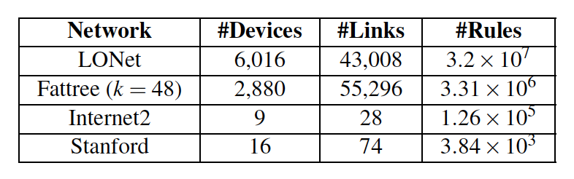
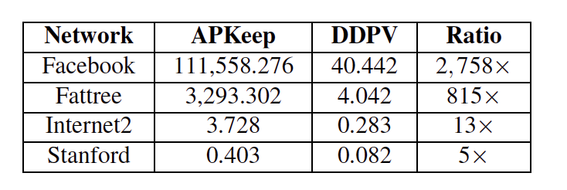
Results
Substantial scaling effect as topology size increases
Up to 2758x speed up than APKeep [7], the state-of-the-art centralized DPV tool
Dataset and the total verification time (s)
[7] Zhang, Peng, Xu Liu, Hongkun Yang, Ning Kang, Zhengchang Gu, and Hao Li. "APKeep: Realtime verification for real networks." In NSDI'20, pp. 241-255. 2020.

Slide 27
Summary
A Generic, Distributed Data Plane Verification Framework
From centralized DP verification to backward, distributed couting
Substantial scaling effect on large networks
Ongoing investigation: applying DDPV output to improve network reliability

Slide 28
This Talk: Recent Results on Scaling Network Verification
CPV
Batfish
Minesweeper
ARC
Tiramisu
…
Network
Network
Challenge 1:
How to simultaneously achieve high coverage (e.g., all converged states) and high efficiency?
Progress 3:
A Privacy-Preserving SAT Solver
Progress 1:
A Solvability Digraph Perspective of
the Stable Path Problem
Challenge 3:
How to verify interdomain network while preserving network privacy?
Control plane
OSPF
BGP
…
config
config
config
DPV
Anteater
HAS
Veriflow
AP
APKeep
…
FIB
ACL
Challenge 2:
How to swiftly verify generic properties in large-scale networks (e.g., data center networks)?
Progress 2:
A Generic, Distributed Data Plane
Verification Framework
Data plane

Slide 29
Background: Interdomain Peering
Two peering ASes (A and B) sometimes reach agreements on route selection / export policies
Such agreements can be formal (i.e., legal contract) or less formal (i.e., published BGP community attributes)
Examples of peering agreements [8]
Selective route export: A asks B to not announce A’s route to certain ASes
Set local preference: A asks B to set the local preference of A’s route to a certain value
Select shorter AS-path: A asks B to select the shortest AS-path and announce it to A
Driving question: Given two ASes A and B, how can A verify that B’s internal operation is following a certain agreement?
[8] Zhao, Mingchen, Wenchao Zhou, Alexander JT Gurney, Andreas Haeberlen, Micah Sherr, and Boon Thau Loo. "Private and verifiable interdomain routing decisions." In ACM SIGCOMM, 2012.

Slide 30
IVeri: Architecture and Key Design Points
A SAT model of interdomain peering agreement verification, motivated by Minesweeper
A privacy-preserving SAT solver

Slide 31
Privacy-Preserving SAT Solver
Basic Idea: Instead of hiding the search history in the garbled circuit with high overhead, expose a disguised search history that no party can recover independently.
Step 1: Permute the order of variables in the verification formula, and share the permutation as pieces of secrets between two parties
A holds a double-permuted, encrypted version of [F_A F_B], and one permutation
B holds the encryption key and the other permutation
Step 2: Encode the DPLL algorithm in a garbled circuit not hiding the search history of permuted variables.
Analysis: Privacy preserving under semi-honest privacy model

Slide 32
Results: Functionality Check
5 representative peering agreements
4 simple BGP configuration files
100% correctness (15 correct implementation, 5 incorrect implementation)

Slide 33
Results: Scalability
Substantial computation overhead than the original DPLL algorithm
Tens of seconds in absolute value

Slide 34
Summary
A Privacy-Preserving, Interdomain Peering Configuration Verification Framework
A privacy-preserving SAT solver
Ongoing investigation: (1) accelerating pp-SAT using new SMPC primitives; (2) accelerating pp-SAT using switching ASICs, (3) extending pp-SAT from 2 parties to N parties

Slide 35
Conclusion
Network verification faces scaling challenges
Scaling CPV: new theoretical findings on SPP, the foundation of many CPV tools
Scaling DPV: generic, distributed DPV to circumvent the inherent bottleneck of centralized DPV
Interdomain CPV: privacy-preserving peering agreement verification framework
Many exciting, open questions remain in all three directions
For more information and questions, please contact Qiao Xiang at xiangq27@gmail.com / qiaoxiang@xmu.edu.cn

Slide 36
Backup Slides

